Slide 1


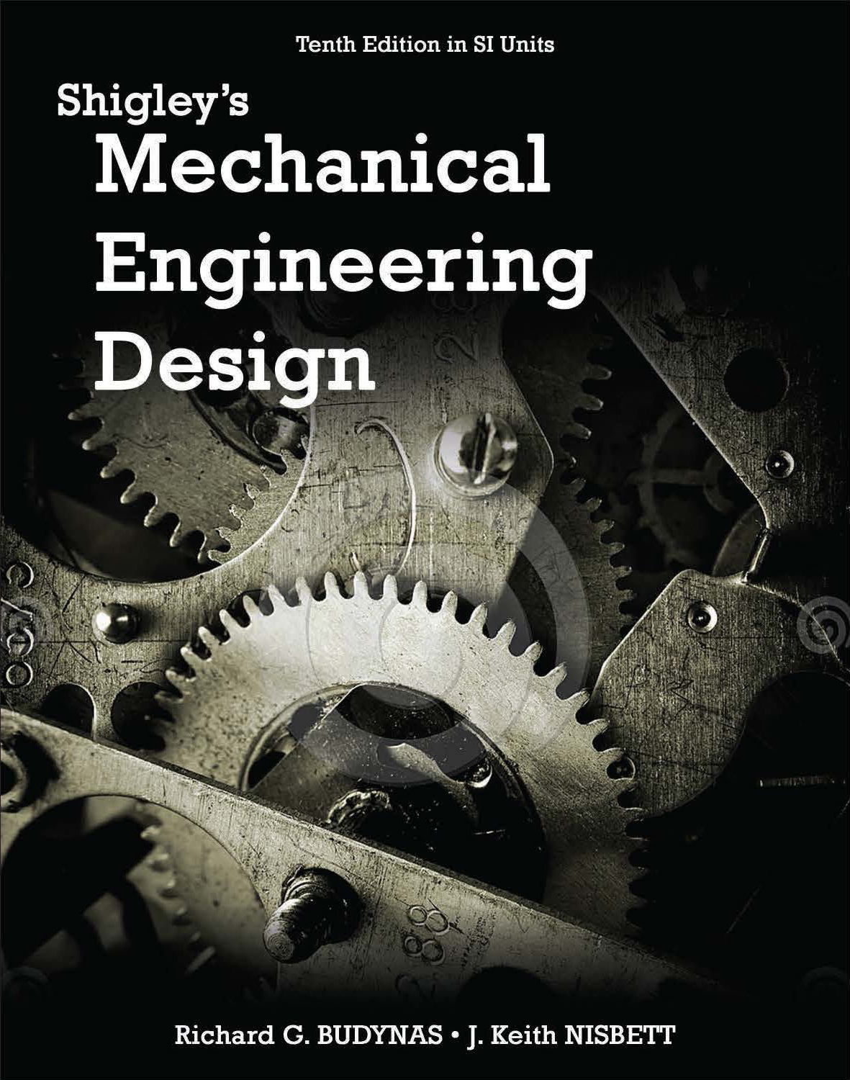
Lecture Slides
Chapter 11
Rolling-Contact Bearings
© 2015 by McGraw-Hill Education. This is proprietary material solely for authorized instructor use. Not authorized for sale or distribution in any manner. This document may not be copied, scanned, duplicated, forwarded, distributed, or posted on a website, in whole or part.

Slide 2
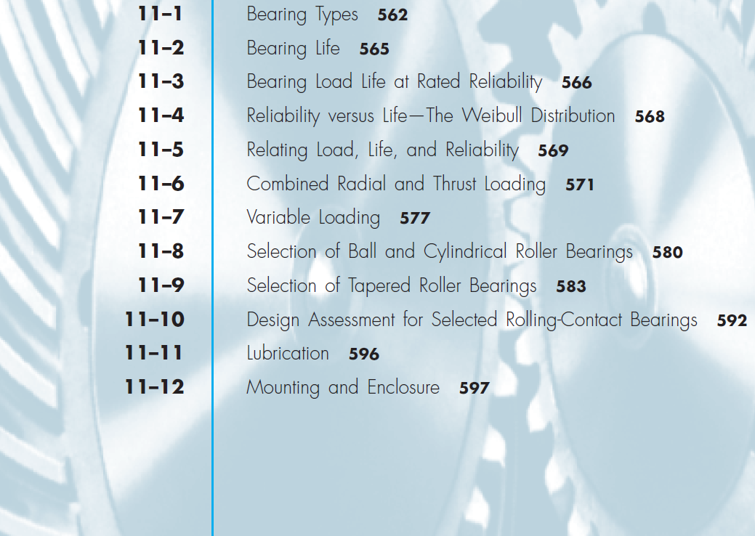
Chapter Outline

Slide 3
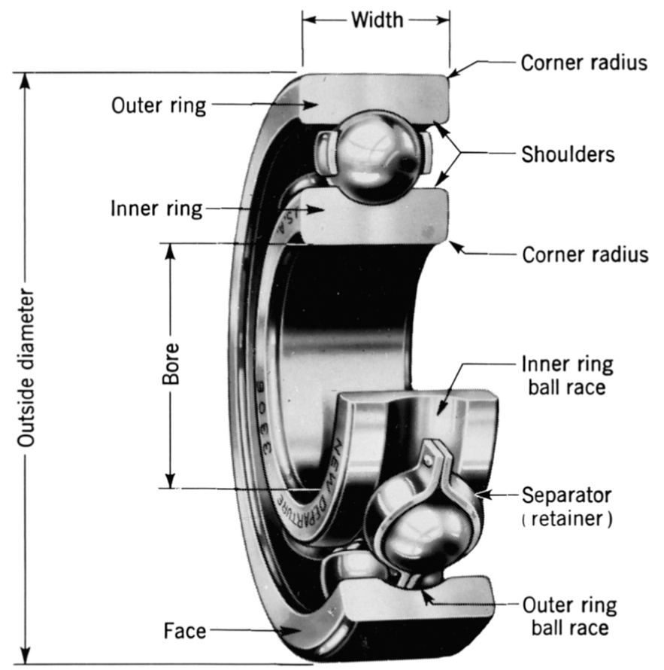
Nomenclature of a Ball Bearing
Fig. 11–1

Slide 4
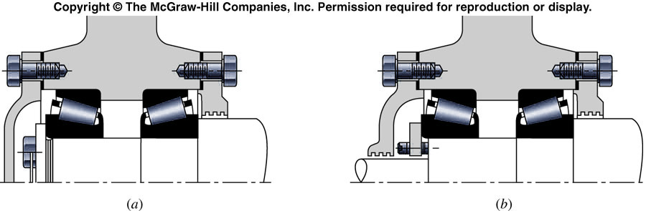
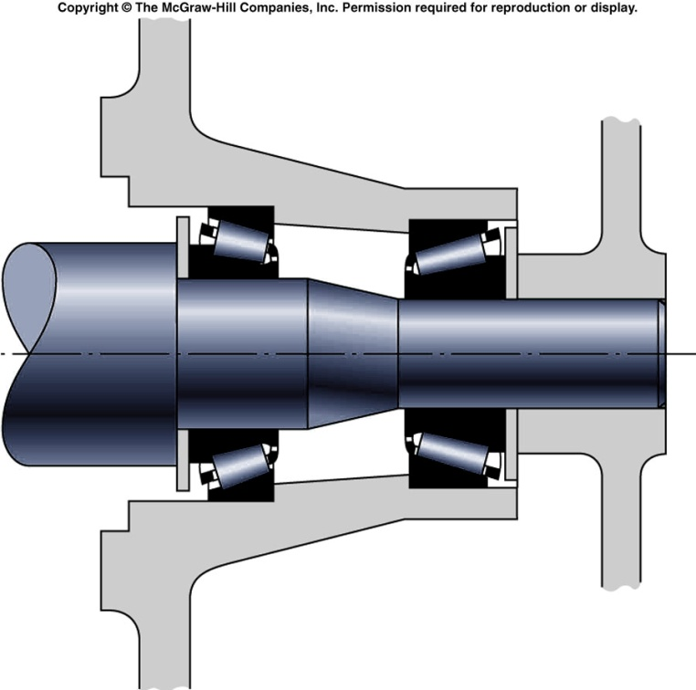
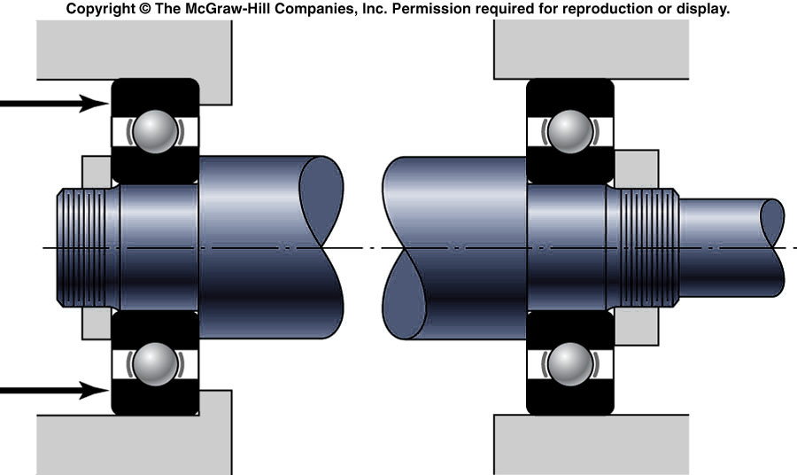

Slide 5
The purpose of the bearing: transfer rotational external load to structure, or vise versa.
1.Rolling-contact bearing, antifriction bearing, and rolling bearing are all used to describe the class of bearing in which the main load is transferred through elements in rolling contact rather than in sliding contact.
2.Starting (static) friction of the rolling bearing is twice the running (dynamic) friction, but is still negligible in comparison with sleeve bearing
3.Load, speed and the operating viscosity of the lubricant do affect the friction characteristics of a rolling bearing.

Slide 6
太大，重心太高
4. Mechanical designer –
a. space limitation
b. load 大小及type of load
c. life for certain speeds, load ,…
d. vibration due to balls contact with cage
Bearing designer – fatigue loading, friction, heat, corrosion resistance, kinematics problem, material properties, lubrication, machining tolerance, assembly, inspection, use, and cost.
(Bearing manufacturing process in the next page)
加一配重

Slide 7
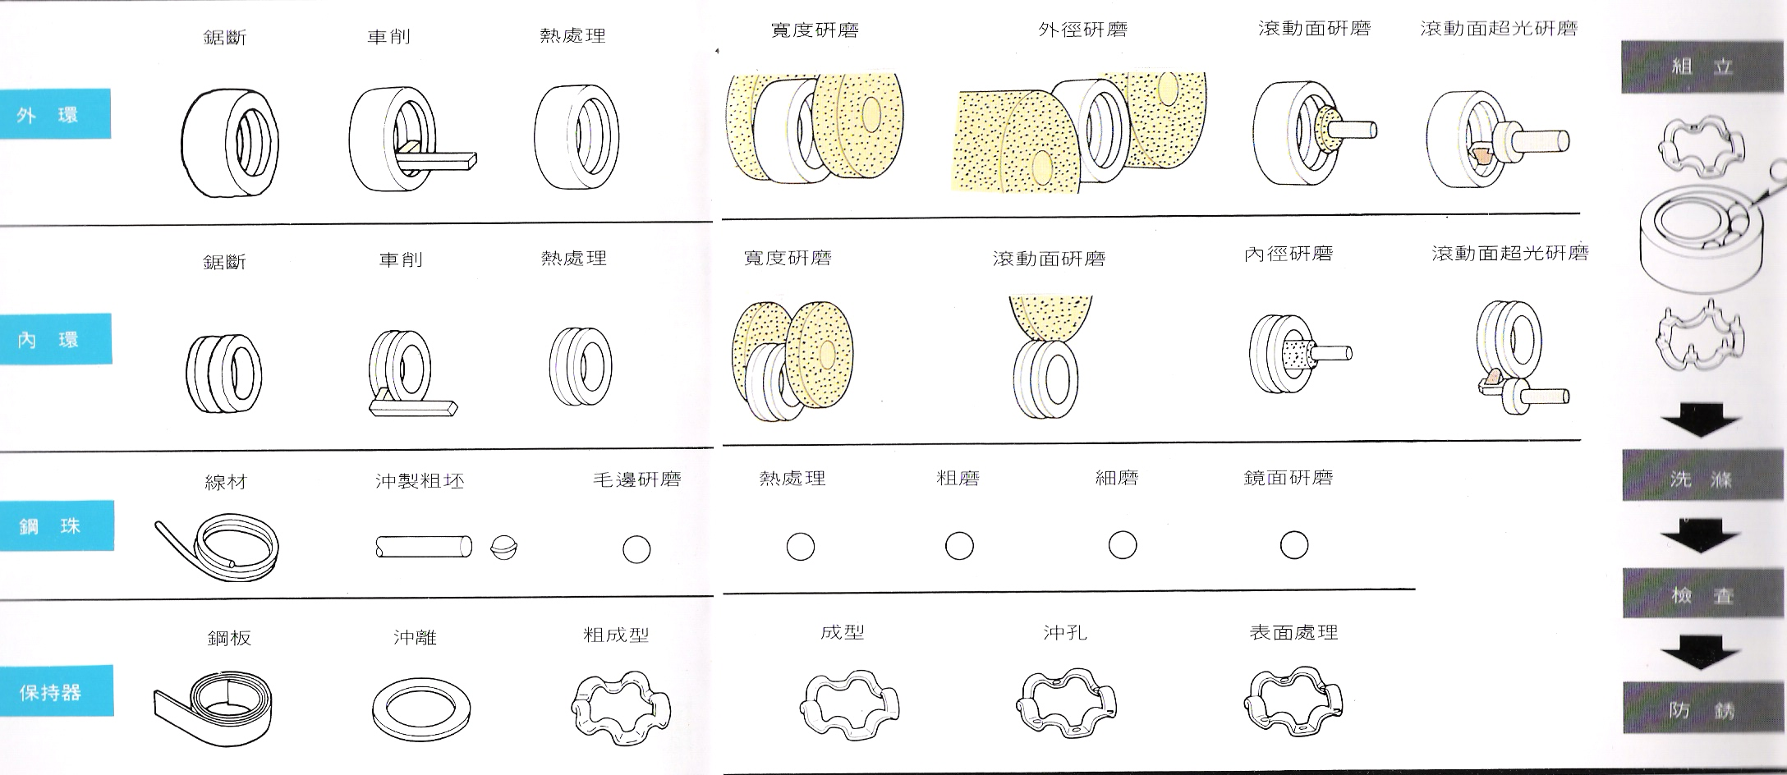

Slide 8
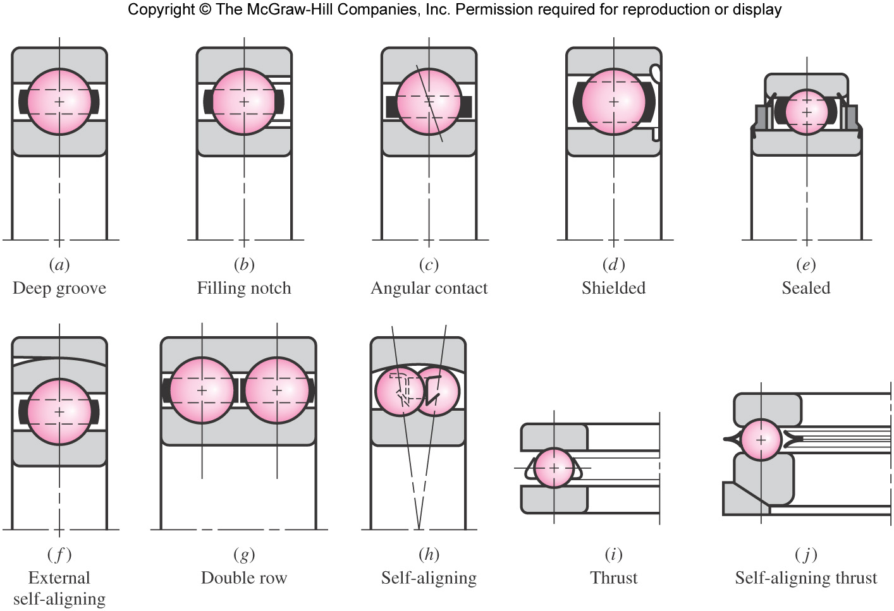
Types of Ball Bearings
Fig. 11–2

Slide 9
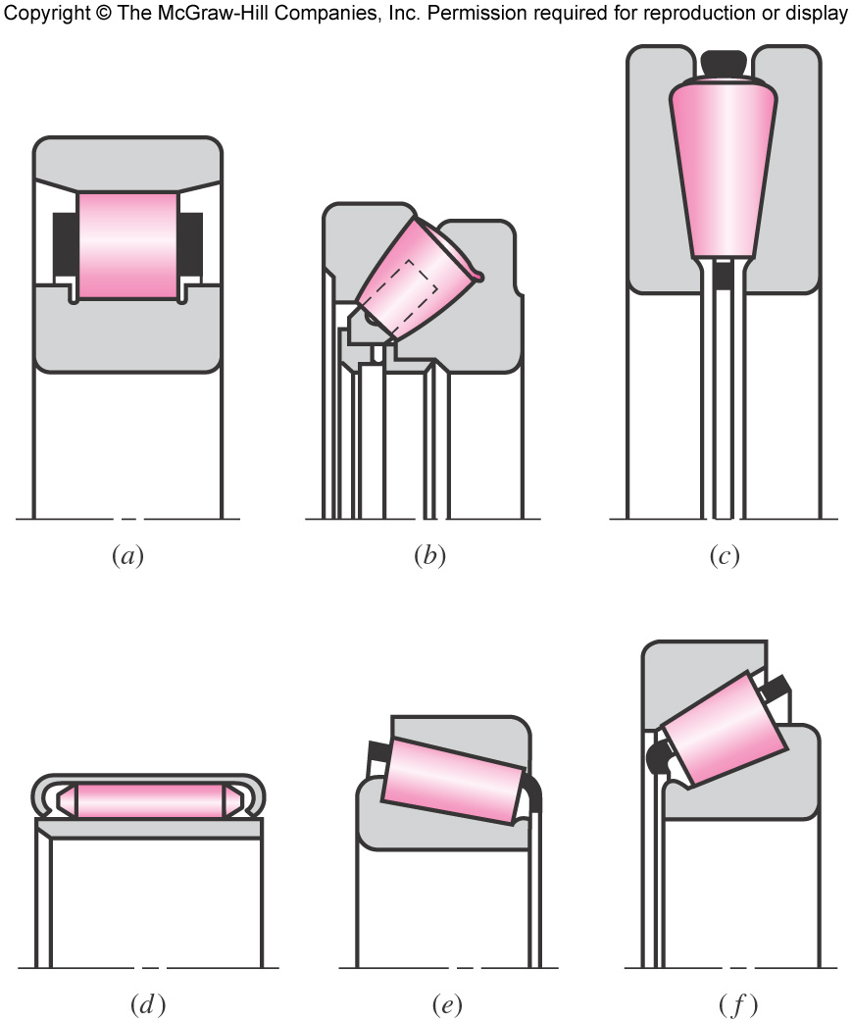
Types of Roller Bearings
Straight Cylindrical
Spherical Roller, thrust
Tapered roller, thrust
Fig. 11–3
Needle
Tapered roller
Steep-angle tapered roller

Slide 10
Bearing Life Definitions
Bearing Failure: Spalling or pitting of an area of 0.01 in²
Life: Number of revolutions (or hours @ given speed) required for failure.
For one bearing
Rating Life: Life required for 10% of sample to fail.
For a group of bearings
Also called Minimum Life or L₁₀ Life
Median Life: Average life required for 50% of sample to fail.
For many groups of bearings
Also called Average Life or Average Median Life
Median Life is typically 4 or 5 times the L₁₀ Life

Slide 11
Load Rating Definitions
Catalog Load Rating, C₁₀: Constant radial load that causes 10% of a group of bearings to fail at the bearing manufacturer’s rating life.
Depends on type, geometry, accuracy of fabrication, and material of bearing
Also called Basic Dynamic Load Rating, and Basic Dynamic Capacity
Basic Load Rating, C: A catalog load rating based on a rating life of 10⁶ revolutions of the inner ring.
The radial load that would be necessary to cause failure at such a low life is unrealistically high.
The Basic Load Rating is a reference value, not an actual load.

Slide 12
Load Rating Definitions
Static Load Rating, C_{o}: Static radial load which corresponds to a permanent deformation of rolling element and race at the most heavily stressed contact of 0.0001d.
d = diameter of roller
Used to check for permanent deformation
Used in combining radial and thrust loads into an equivalent radial load
Equivalent Radial Load, F_{e}: Constant stationary load applied to bearing with rotating inner ring which gives the same life as actual load and rotation conditions.

Slide 13
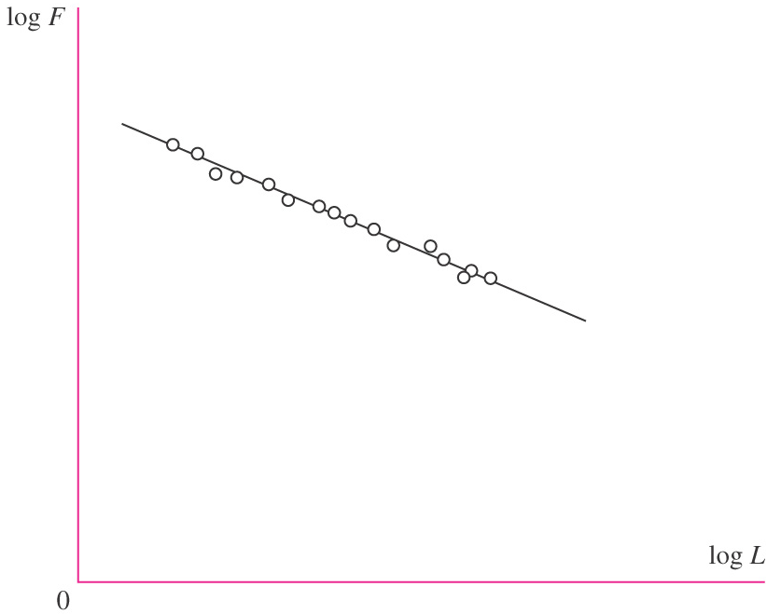
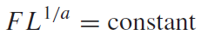
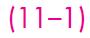
Load-Life Relationship
Nominally identical groups of bearings are tested to the life-failure criterion at different loads.
A plot of load vs. life on log-log scale is approximately linear.
Using a regression equation to represent the line,
a = 3 for ball bearings
a = 10/3 for roller bearings (cylindrical and tapered roller)
Fig. 11–4

Slide 14
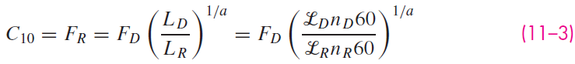
Load-Life Relationship
Applying Eq. (11–1) to two load-life conditions,
Denoting condition 1 with R for catalog rating conditions, and condition 2 with D for the desired design conditions,
The units of L are revolutions. If life is given in hours at a given speed n in rev/min, applying a conversion of 60 min/h,
Solving Eq. (a) for F_{R}, which is just another notation for the catalog load rating,

Slide 15
Load-Life Relationship
The desired design load F_{D} and life L_{D} come from the problem statement.
The rated life L_{R} will be stated by the specific bearing manufacturer. Many catalogs rate at L_{R} = 10⁶ revolutions.
The catalog load rating C₁₀ is used to find a suitable bearing in the catalog.

Slide 16
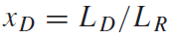
Load-Life Relationship
It is often convenient to define a dimensionless multiple of rating life

Slide 17
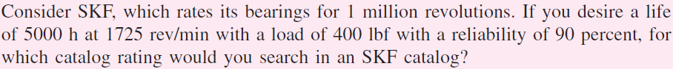
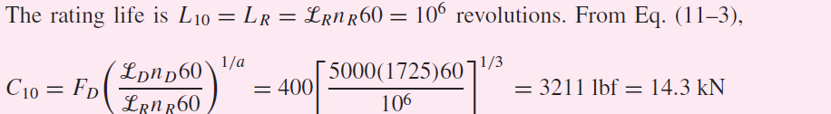
Example 11–1

Slide 18
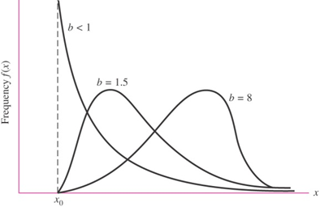
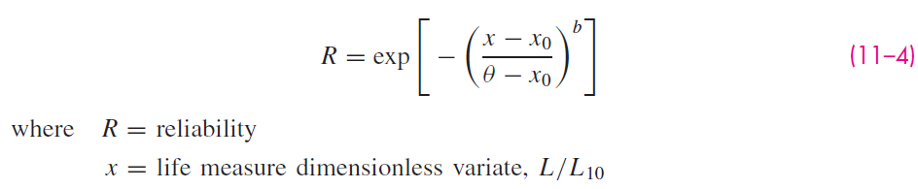
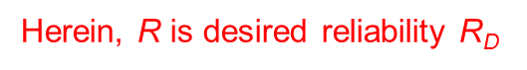
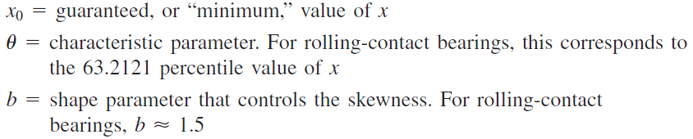
Reliability vs. Life
If the reliability is not 90%, sometime larger than 90%, then we need to use Eq. 11-6 or 11-7 to find the C₁₀ at required R_{D} , L_{D} and F_{D}.
At constant load, the life measure distribution is right skewed.
The Weibull distribution is a good candidate.
Defining the life measure in dimensionless form as x = L/L₁₀, the reliability is expressed with a Weibull distribution as

Slide 19
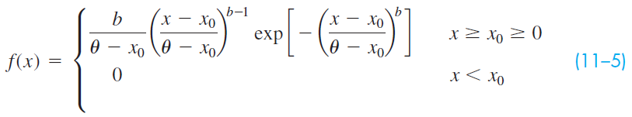
Reliability vs. Life
From Eq. (1–8), R = 1 – p, where p is the probability of a value of x occurring between –∞ and x.
p is the integral of the probability distribution f(x).
From the derivative of Eq. (11–4), the Weibull probability density function is

Slide 20
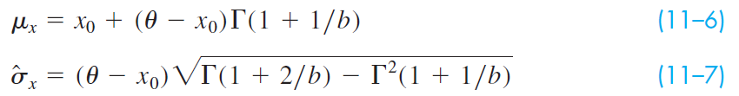
Reliability vs. Life
The mean and standard deviation of f(x) are
Γ is the gamma function, and is tabulated in Table A–34

Slide 21
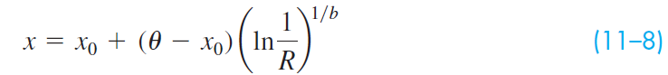
Reliability vs. Life
Solving Eq. (11–4) for x yields

Slide 22
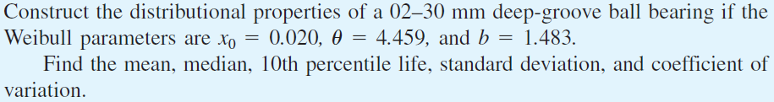
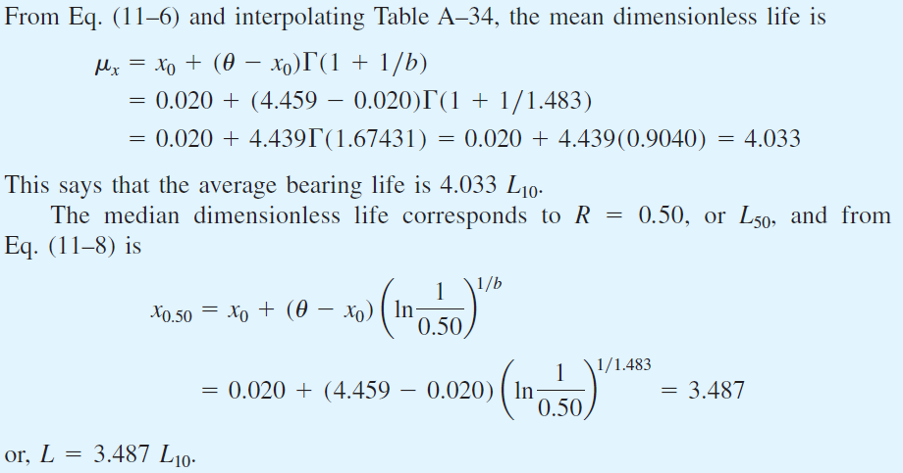
Example 11–2

Slide 23
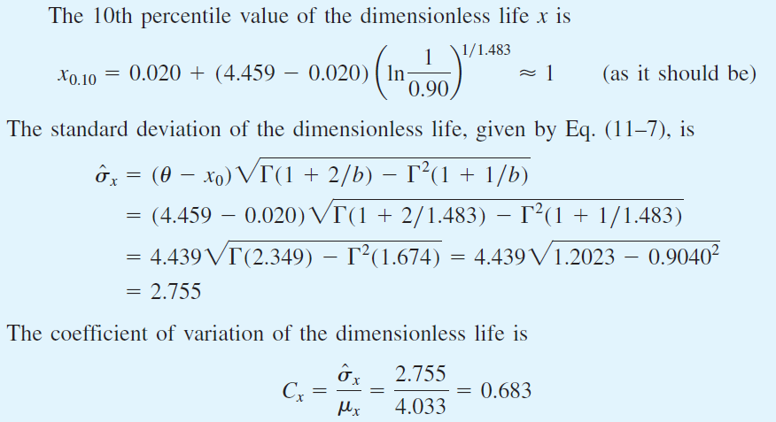
Example 11–2 (continued)

Slide 24
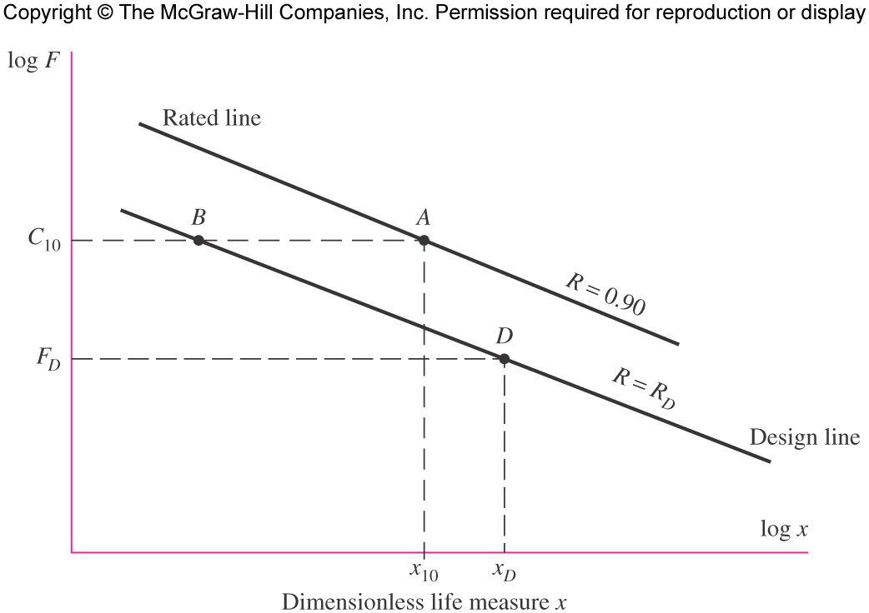
Relating Load, Life, and Reliability
Catalog information is at point A, at coordinates C₁₀ and x₁₀=L₁₀/L₁₀=1, on the 0.90 reliability contour.
The design information is at point D, at coordinates F_{D} and x_{D}, on the R=R_{D} reliability contour.
The designer must move from point D to point A via point B.
Fig. 11–5

Slide 25
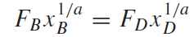
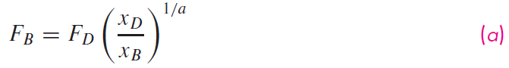
Relating Load, Life, and Reliability
Along a constant reliability contour (BD), Eq. (11–2) applies:
Fig. 11–5

Slide 26
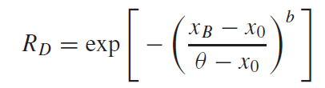
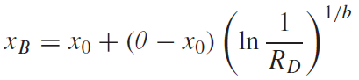
Relating Load, Life, and Reliability
Along a constant load line (AB), Eq. (11–4) applies:
Solving for x_{B},
Fig. 11–5

Slide 27
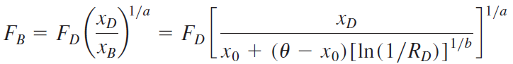
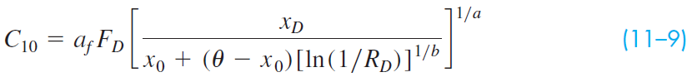
Relating Load, Life, and Reliability
Substituting x_{B} into Eq. (a),
Noting that F_{B} = C₁₀, and including an application factor a_{f},
Note that when R_{D} = 0.90, the denominator equals one and the equation reduces to Eq. (11–3).

Slide 28
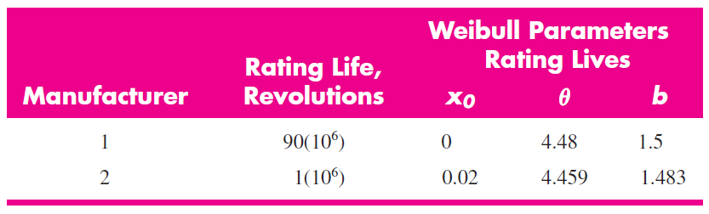
Weibull Parameters
The Weibull parameters x₀, θ, and b are usually provided by the catalog.
Typical values of Weibull parameters are given on p. 601 at the beginning of the end-of-chapter problems, and shown below.
Manufacturer 1 parameters are common for tapered roller bearings
Manufacturer 2 parameters are common for ball and straight roller bearings

Slide 29
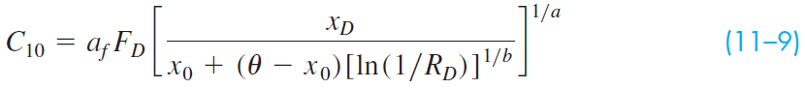
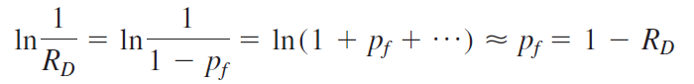
Relating Load, Life, and Reliability
Eq. (11–9) can be simplified slightly for calculator entry. Note that
where p_{f} is the probability for failure
Thus Eq. (11–9) can be approximated by

Slide 30
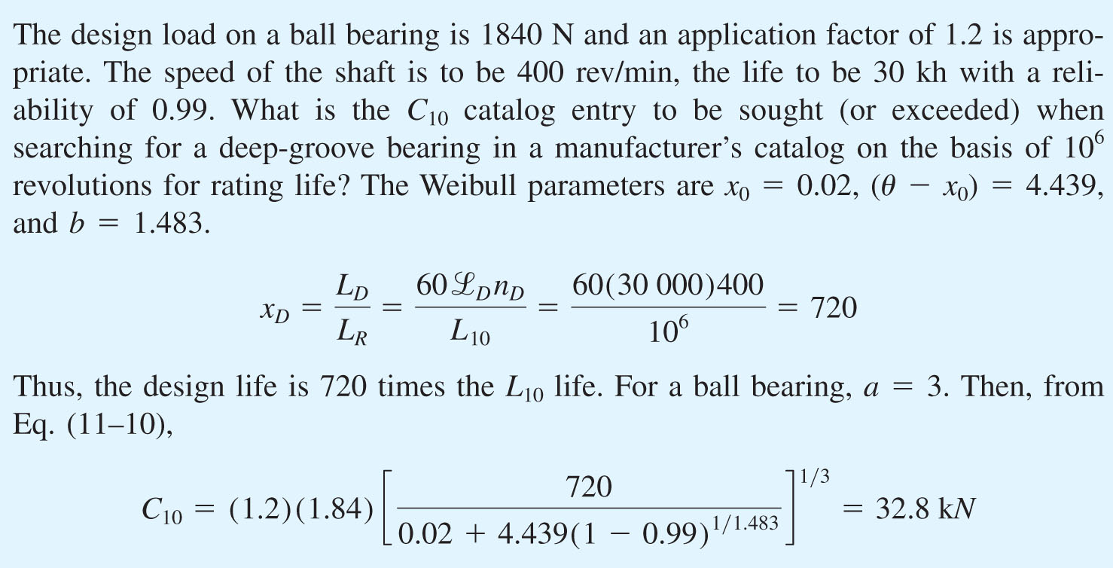
Example 11–3

Slide 31
Combined Reliability of Multiple Bearings
If the combined reliability of multiple bearings on a shaft, or in a gearbox, is desired, then the total reliability is equal to the product of the individual reliabilities.
For two bearings on a shaft, R = R_{A}R_{B}
If the bearings are to be identical, each bearing should have a reliability equal to the square root of the total desired reliability.
If the bearings are not identical, their reliabilities need not be identical, so long as the total reliability is realized.

Slide 32
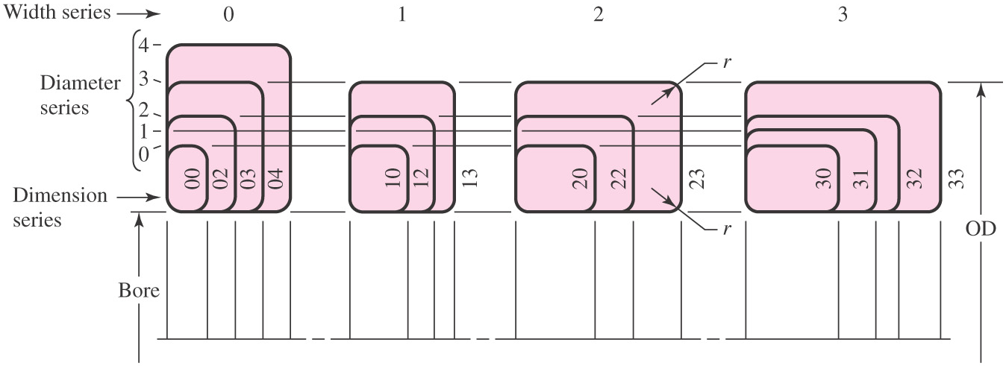
Dimension-Series Code
ABMA standardized dimension-series code represents the relative size of the boundary dimensions of the bearing cross section for metric bearings.
Two digit series number
First digit designates the width series
Second digit designates the diameter series
Specific dimensions are tabulated in catalogs under a specific series
Fig. 11–7

Slide 33
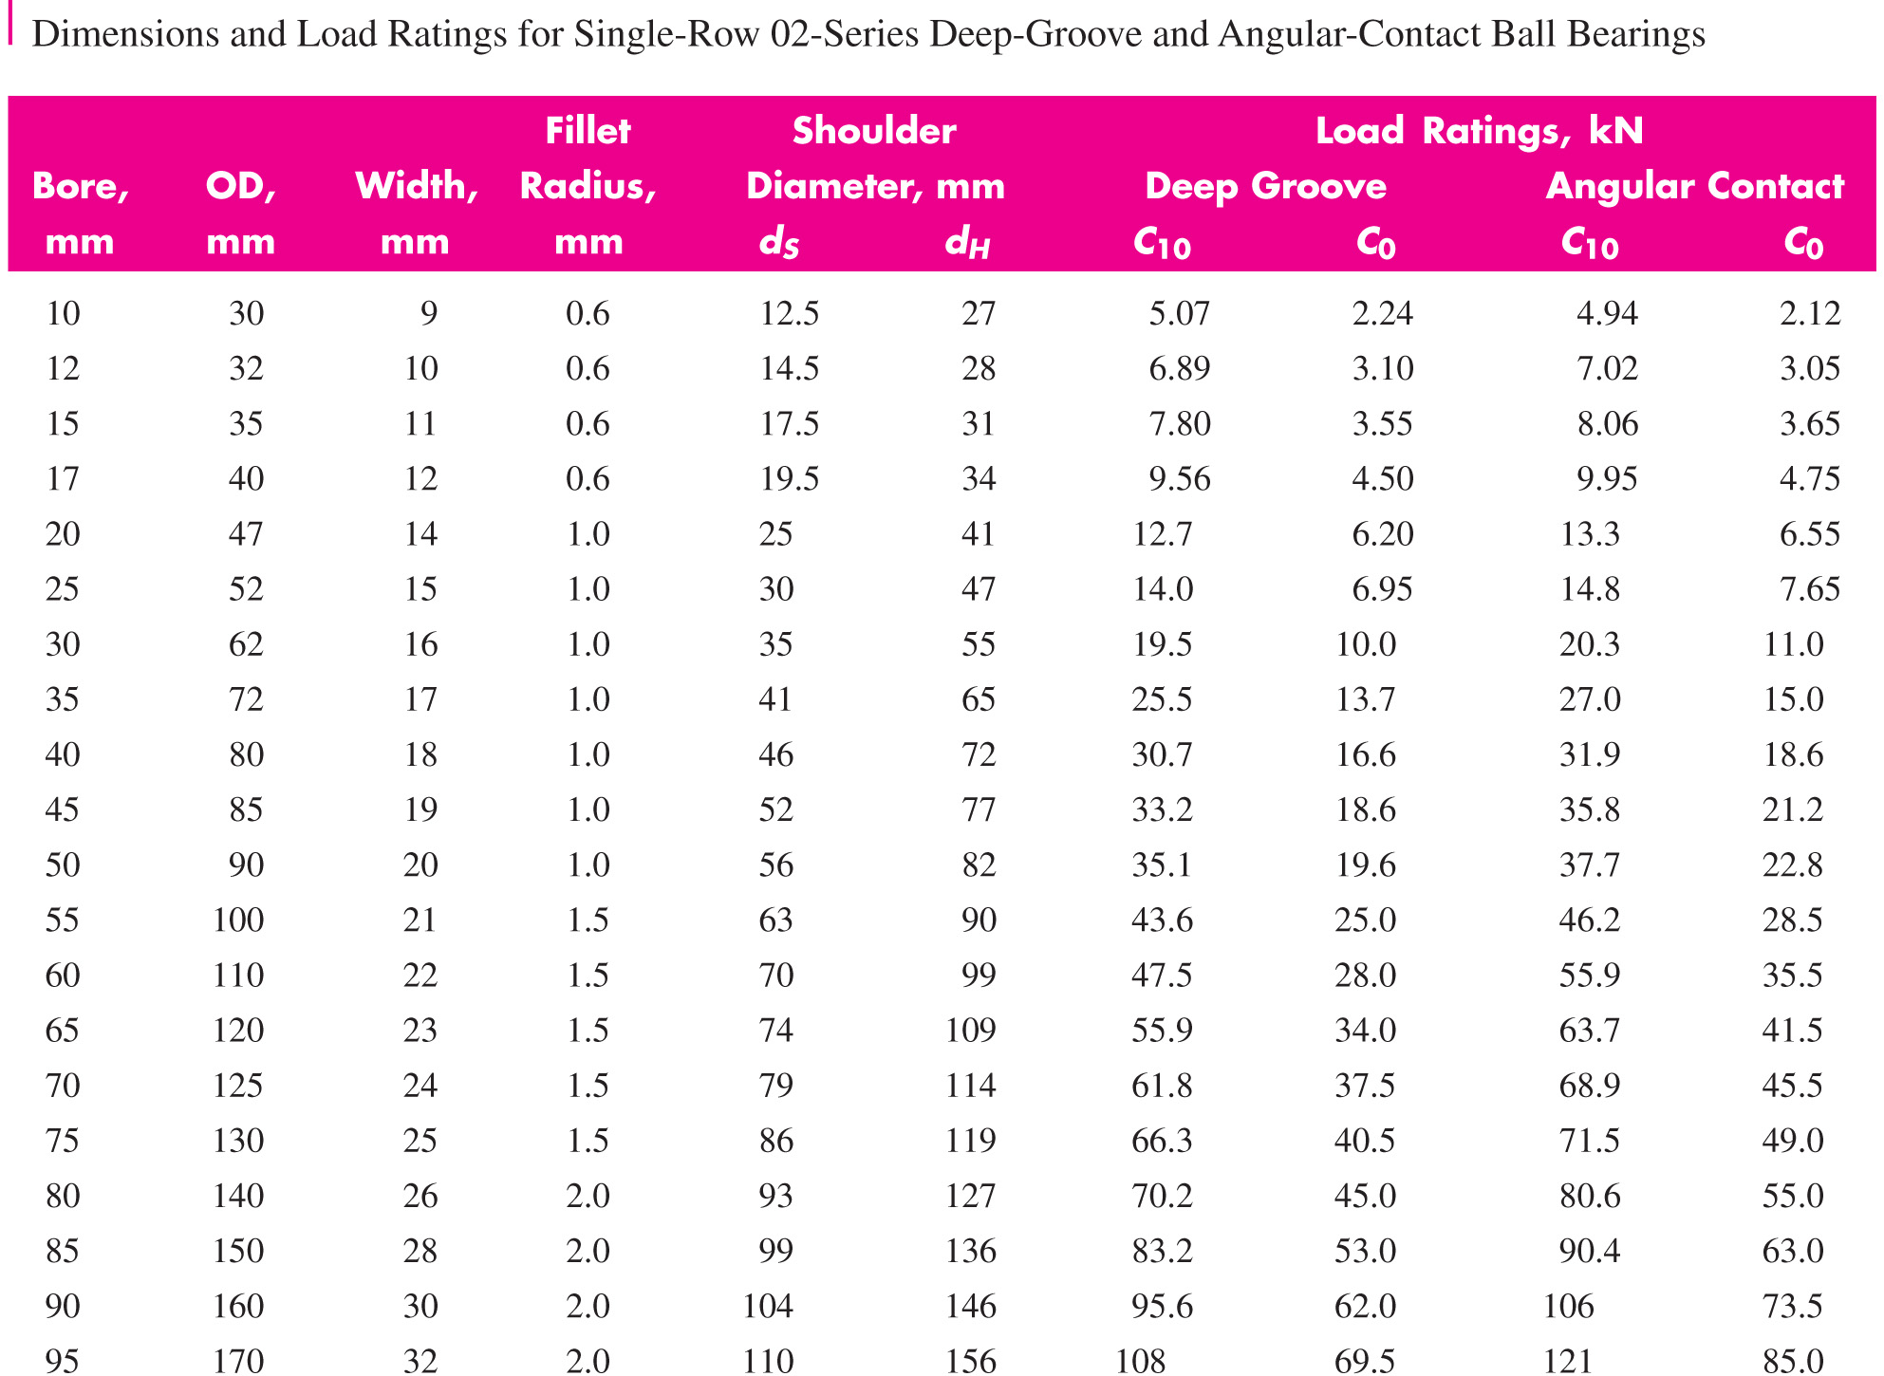
Representative Catalog Data for Ball Bearings (Table 11–2)

Slide 34
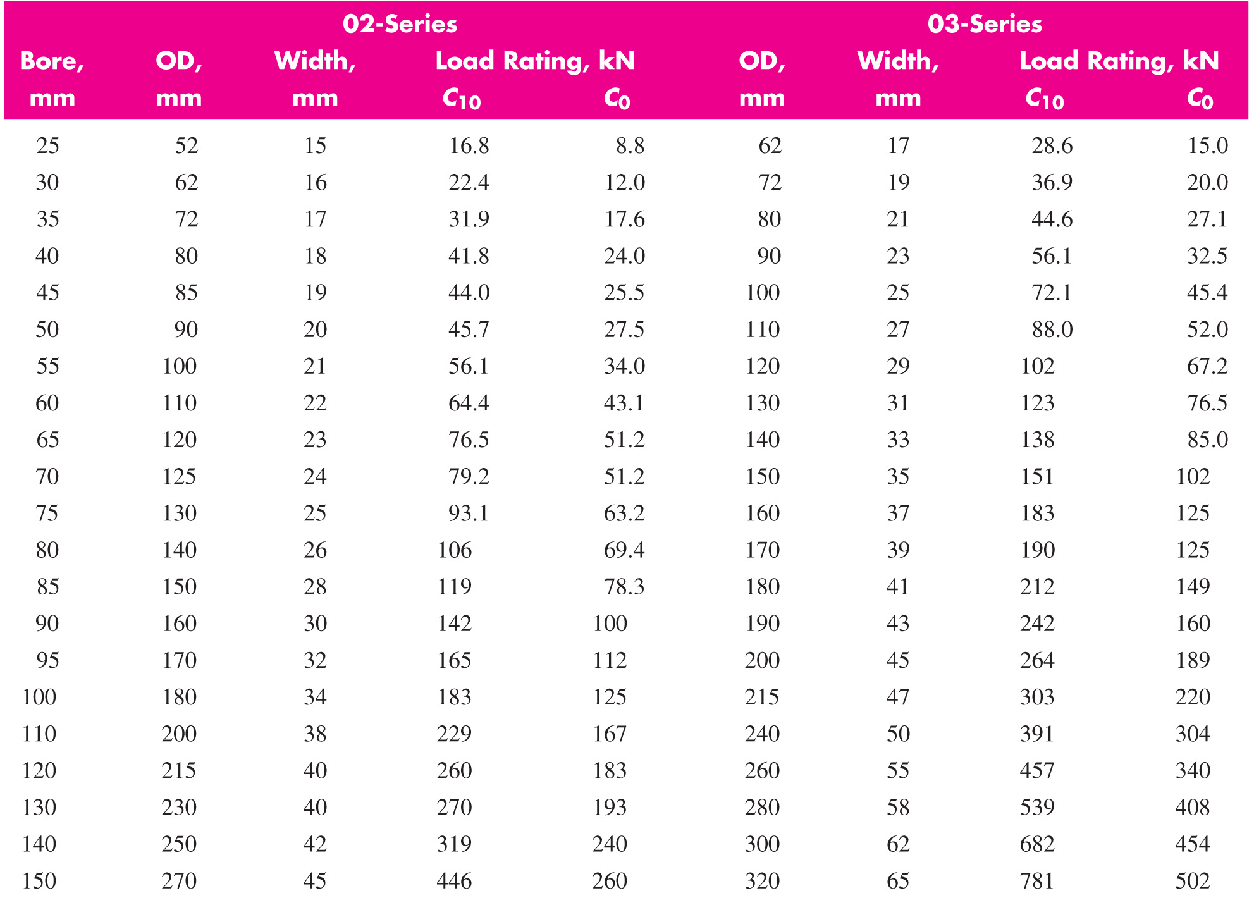
Representative Catalog Data for Cylindrical Roller Bearings (Table 11–3)

Slide 35
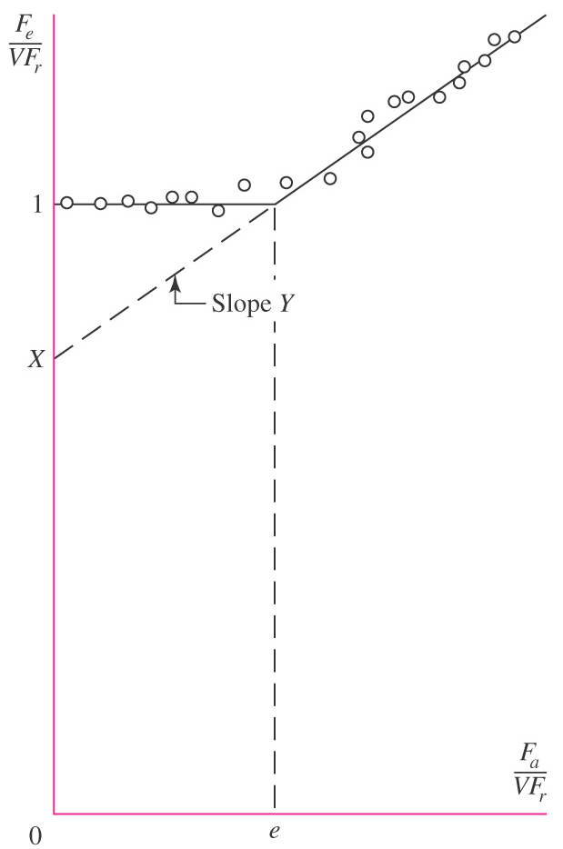
Combined Radial and Thrust Loading
When ball bearings carry both an axial thrust load F_{a} and a radial load F_{r}, an equivalent radial load F_{e} that does the same damage is used.
A plot of F_{e}/(VF_{r}) vs. F_{a} /(VF_{r}) is obtained experimentally.
V is a rotation factor to account for the difference in ball rotations for outer ring rotation vs. inner ring roation.
V = 1 for inner ring rotation
V = 1.2 for outer ring rotation
Fig. 11–6

Slide 36
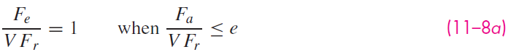
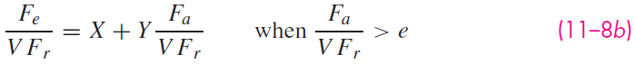
Combined Radial and Thrust Loading
The data can be approximated by two straight lines
X is the ordinate intercept and Y is the slope
Basically indicates that F_{e} equals F_{r} for smaller ratios of F_{a}/F_{r}, then begins to rise when F_{a}/F_{r} exceeds some amount e
Fig. 11–6

Slide 37
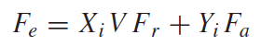
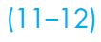
Combined Radial and Thrust Loading
It is common to express the two equations as a single equation
where
i = 1 when F_{a} /(VF_{r}) ≤ e
i = 2 when F_{a} /(VF_{r}) > e
X and Y factors depend on geometry and construction of the specific bearing.
Fig. 11–6

Slide 38
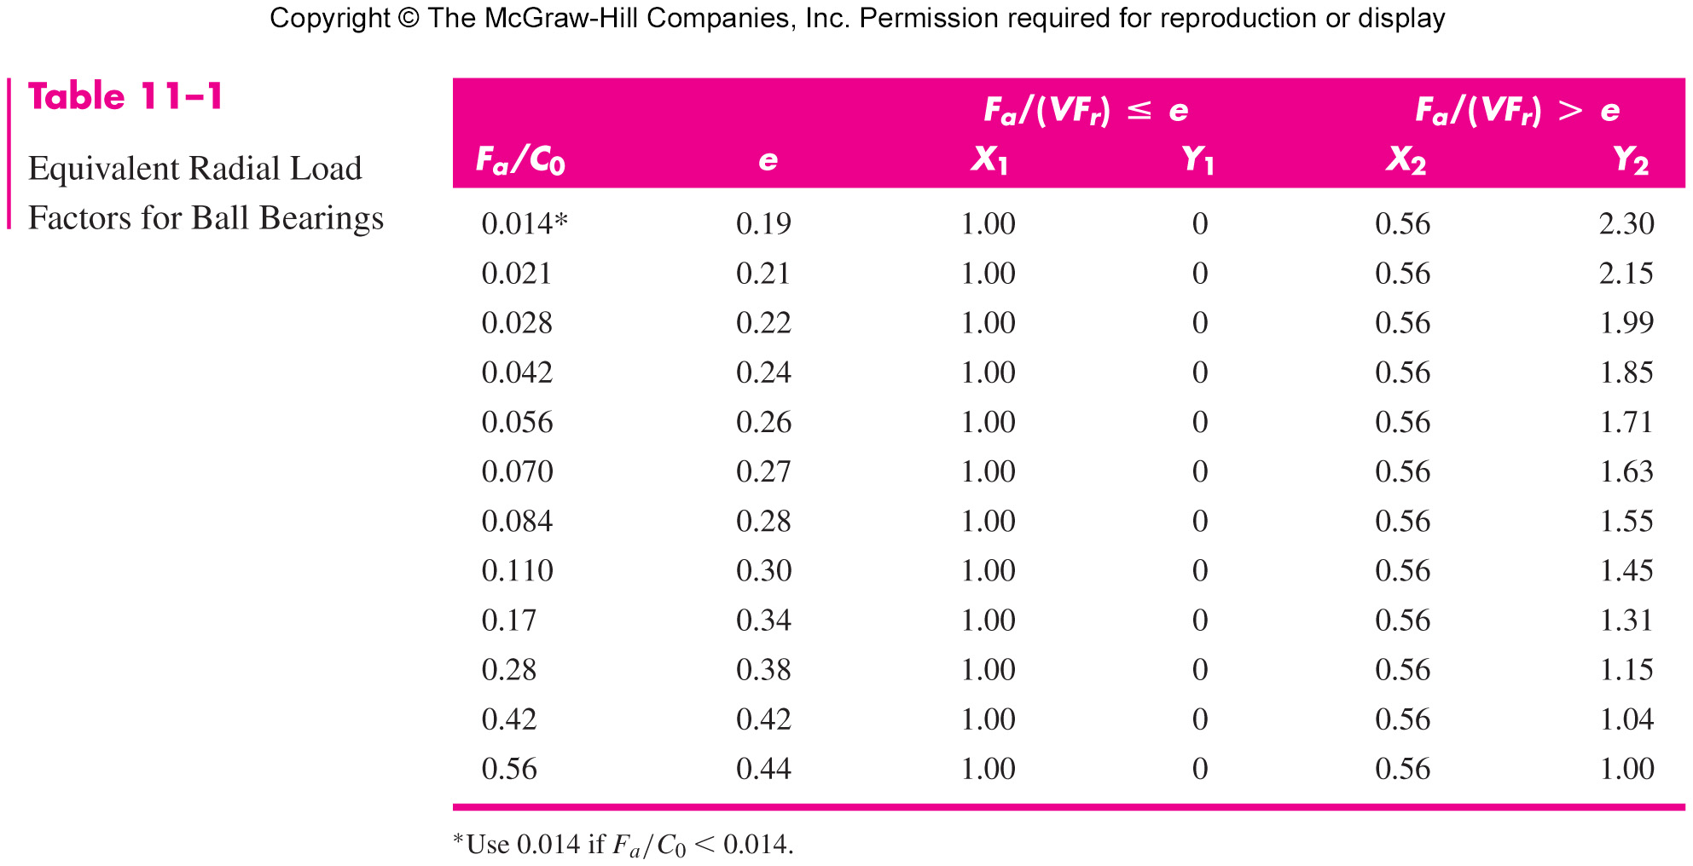
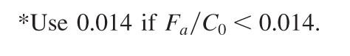
Equivalent Radial Load Factors for Ball Bearings
X and Y for specific bearing obtained from bearing catalog.
Table 11–1 gives representative values in a manner common to many catalogs.
Table 11–1

Slide 39
Equivalent Radial Load Factors for Ball Bearings
Table 11–1
X and Y are functions of e, which is a function of F_{a}/C₀.
C₀ is the basic static load rating, which is tabulated in the catalog.

Slide 40
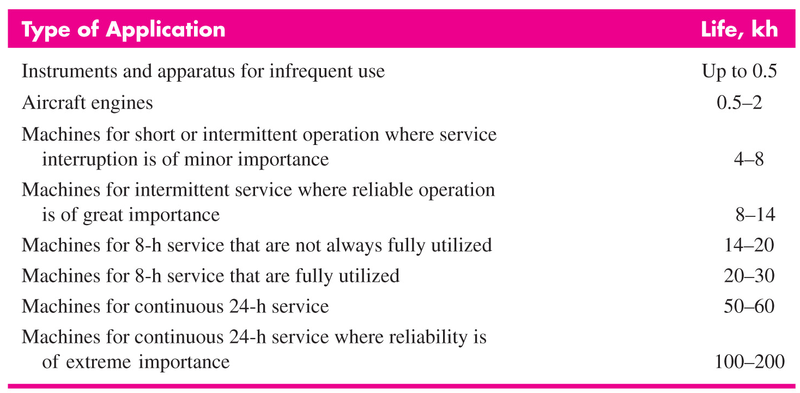
Bearing Life Recommendations (Table 11–4)

Slide 41
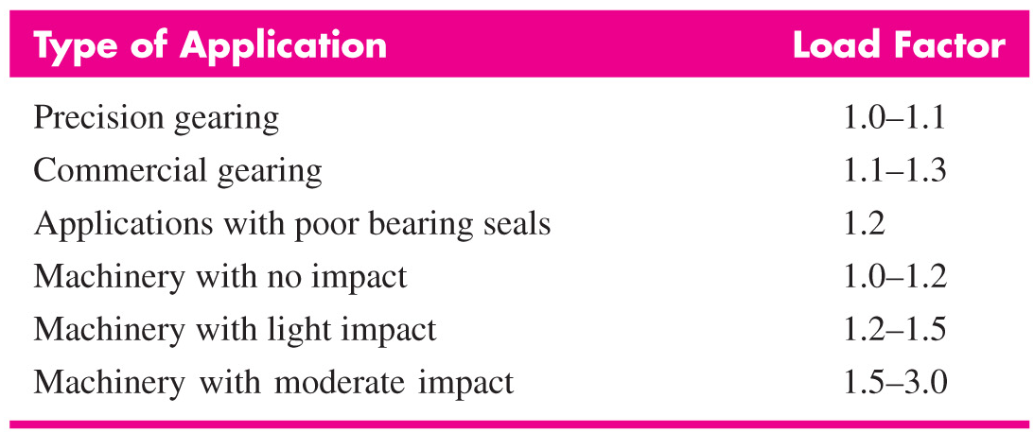
Recommended Load Application Factors (Table 11–5)

Slide 42
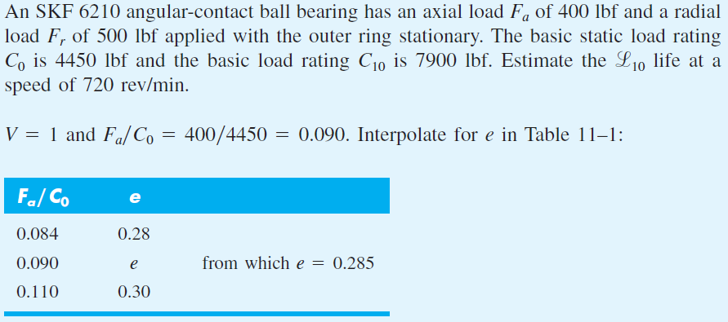
Example 11–4

Slide 43

Example 11–4 (continued)

Slide 44

Variable Loading

Slide 45

Variable Loading with Piecewise Constant Loading

Slide 46



Variable Loading with Piecewise Constant Loading

Slide 47

Example 11–5

Slide 48

Example 11–5 (continued)

Slide 49




Variable Loading with Piecewise Constant Loading

Slide 50




Variable Loading with Periodic Variation
Fig. 11–11

Slide 51


Example 11–6

Slide 52

Example 11–6 (continued)

Slide 53


Example 11–7
Fig. 11–12

Slide 54

Example 11–7

Slide 55

Example 11–7

Slide 56

Example 11–7

Slide 57

Example 11–7 (continued)

Slide 58
Tapered Roller Bearings
Straight roller bearings can carry large radial loads, but no axial load.
Ball bearings can carry moderate radial loads, and small axial loads.
Tapered roller bearings rely on roller tipped at an angle to allow them to carry large radial and large axial loads.
Tapered roller bearings were popularized by the Timken Company.

Slide 59

Tapered Roller Bearings
Two separable parts
Cone assembly
Cone (inner ring)
Rollers
Cage
Cup (outer ring)
Rollers are tapered so virtual apex is on shaft centerline
Taper allows for pure rolling of angled rollers
Distance a locates the effective axial location for force analysis
Fig. 11–13

Slide 60

Mounting Directions of Tapered Roller Bearings
Mount pairs in opposite directions to counter the axial loads
Can be mounted in direct mounting or indirect mounting configurations
For the same effective spread a_{e}, direct mounting requires greater geometric spread a_{g}
For the same geometric spread a_{g}, direct mounting provides smaller effect spread a_{e}
Fig. 11–14

Slide 61

Typical Catalog Data (Fig. 11–15)

Slide 62

Typical Catalog Data (Fig. 11–15)

Slide 63

Typical Catalog Data (Fig. 11–15 continued)

Slide 64

Typical Catalog Data (Fig. 11–15 continued)

Slide 65


Induced Thrust Load
A radial load induces a thrust reaction due to the roller angle.
K is ratio of radial load rating to thrust load rating
K is dependent on specific bearing, and is tabulated in catalog
Fig. 11–16

Slide 66


Equivalent Radial Load
The equivalent radial load for tapered roller bearings is found in similar form as before,
Timken recommends X = 0.4 and Y = K
F_{a} is the net axial load carried by the bearing, including induced thrust load from the other bearing and the external axial load carried by the bearing.
Only one of the bearings will carry the external axial load

Slide 67

Determining Which Bearing Carries External Axial Load
Regardless of mounting direction or shaft orientation, visually inspect to determine which bearing is being “squeezed”
Label this bearing as Bearing A
Fig. 11–17

Slide 68

Net Axial Load
Generally, Bearing A (the squeezed bearing) carries the net axial load
Occasionally the induced thrust from Bearing A, F_{iA}, is greater than the combination of the induced thrust from Bearing B, F_{iB}, and the external axial load F_{ae} , that is
If this happens, then Bearing B actually carries the net axial load

Slide 69

Equivalent Radial Load
Timken recommends using the full radial load for the bearing that is not carrying the net axial load.
Equivalent radial load equation:
If the equivalent radial load is less than the original radial load, then use the original radial load.

Slide 70


Example 11–8
Fig. 11–18

Slide 71


Example 11–8 (continued)
Fig. 11–18

Slide 72

Example 11–8 (continued)

Slide 73

Example 11–8 (continued)

Slide 74

Example 11–8 (continued)

Slide 75


Example 11–8 (continued)

Slide 76

Example 11–8 (continued)

Slide 77


Realized Bearing Reliability
Eq. (11–9) was previously derived to determine a suitable catalog rated load for a given design situation and reliability goal.
An actual bearing is selected from a catalog with a rating greater than C₁₀.
Sometimes it is desirable to determine the realized reliability from the actual bearing (that was slightly higher capacity than needed).
Solving Eq. (11–9) for the reliability,

Slide 78

Realized Bearing Reliability
Similarly for the alternate approximate equation, Eq. (11–10),

Slide 79



Example 11–9

Slide 80

Realized Reliability for Tapered Roller Bearings
Substituting typical Weibull parameters for tapered roller bearings into Eqs. (11–21) and (11–22) give realized reliability equations customized for tapered roller bearings.

Slide 81

Example 11–10

Slide 82

Example 11–10 (continued)

Slide 83


Example 11–11
Fig. 11–19

Slide 84


Example 11–11 (continued)

Slide 85

Example 11–11 (continued)

Slide 86

Example 11–11 (continued)

Slide 87
Bearing Lubrication
The purposes of bearing lubrication
To provide a film of lubricant between the sliding and rolling surfaces
To help distribute and dissipate heat
To prevent corrosion of the bearing surfaces
To protect the parts from the entrance of foreign matter

Slide 88

Bearing Lubrication
Either oil or grease may be used, with each having advantages in certain situations.

Slide 89


Some Common Bearing Mounting Configurations
Fig. 11–20
Fig. 11–21

Slide 90

Some Common Bearing Mounting Configurations
Fig. 11–22

Slide 91

Some Common Bearing Mounting Configurations
Fig. 11–23

Slide 92


Slide 93

Duplexing
When maximum stiffness and resistance to shaft misalignment is desired, pairs of angular-contact bearings can be used in an arrangement called duplexing.
Duplex bearings have rings ground with an offset.
When pairs are clamped together, a preload is established.

Slide 94

Duplexing Arrangements
Three common duplexing arrangements:
DF mounting – Face to face, good for radial and thrust loads from either direction
DB mounting – Back to back, same as DF, but with greater alignment stiffness
DT mounting – Tandem, good for thrust only in one direction
Fig. 11–24

Slide 95
Preferred Fits
Rotating ring usually requires a press fit
Stationary ring usually best with a push fit
Allows stationary ring to creep, bringing new portions into the load-bearing zone to equalize wear

Slide 96

Preloading
Object of preloading
Remove internal clearance
Increase fatigue life
Decrease shaft slope at bearing
Fig. 11–25

Slide 97

Alignment
Catalogs will specify alignment requirements for specific bearings
Typical maximum ranges for shaft slopes at bearing locations

Slide 98

Enclosures
Common shaft seals to exclude dirt and retain lubricant
Fig. 11–26

